Slide 1

Financial Dashboard
Vinay Rajagopalan

Slide 2
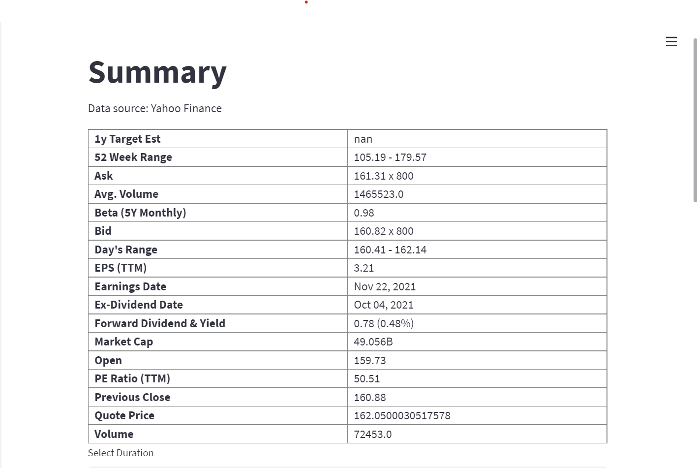
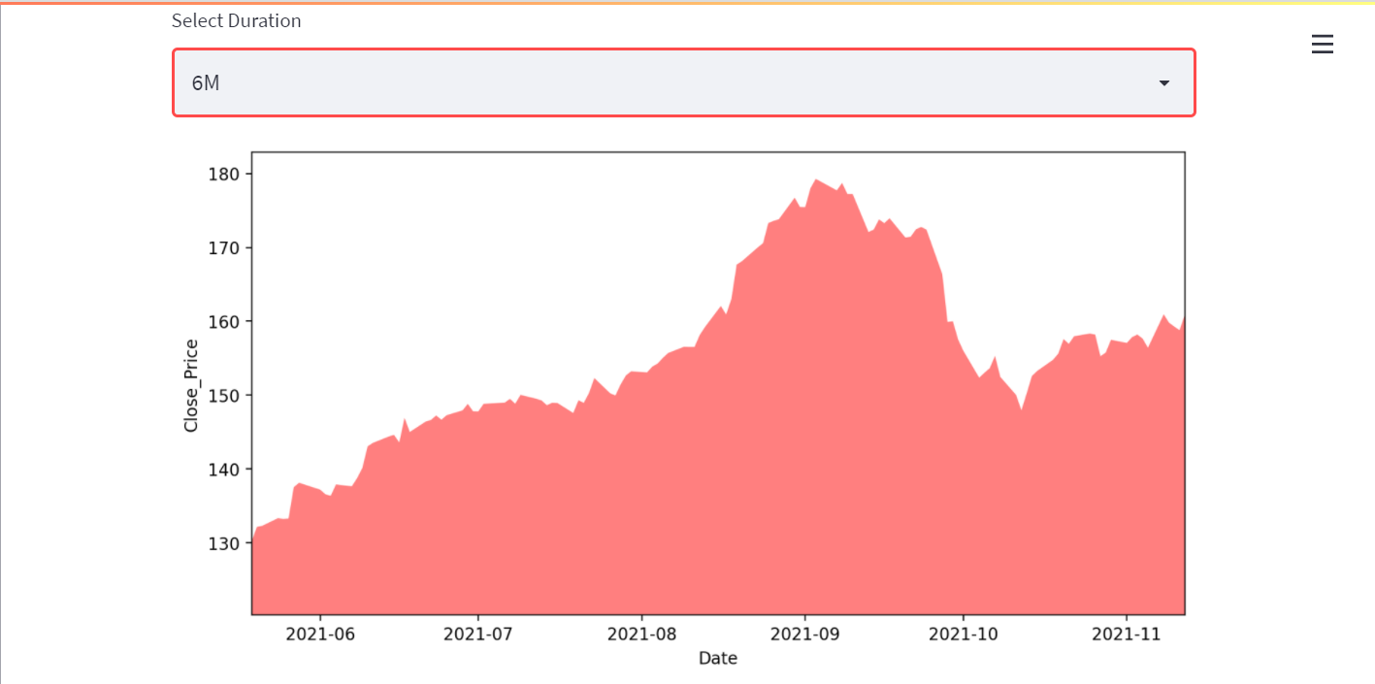
Summary
The summary of the company
A chart displaying time vs close price of the stock for the selected time period. The default value of time period id 30 days.
Libraries Used :
  si.get_quote_table(ticker, dict_result=False)
  si.get_data(tick, start_date, end_date)

Slide 3
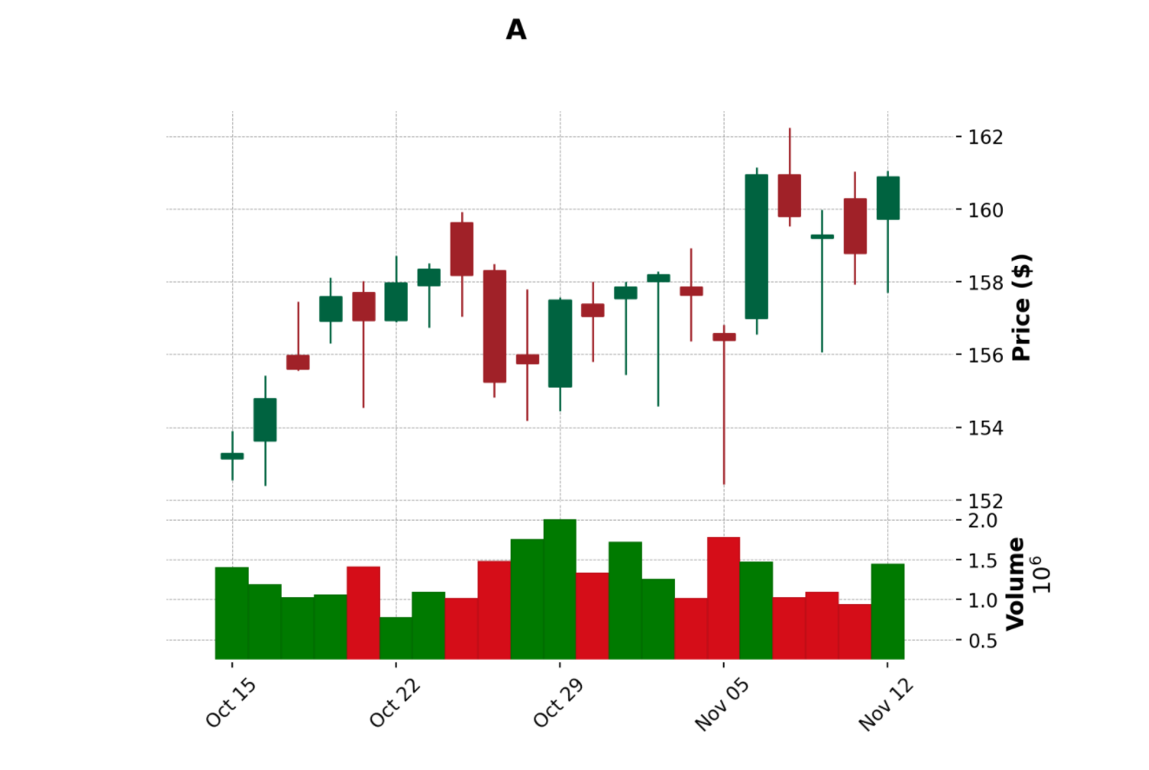
Chart
Candle Stick Plot
  Represents line/candle plot for stock price
  Volume at the bottom
  Mav for 50 days
Libraries Used:
  yfinance : yfin.download(ticker, start=today - timedelta(days=days), end=today,)
  Mplfinance: mpf.plot(df, type=type, style="charles", title=title, ylabel="Price ($)", volume=True, ylabel_lower="Volume", mav=(50),)

Slide 4
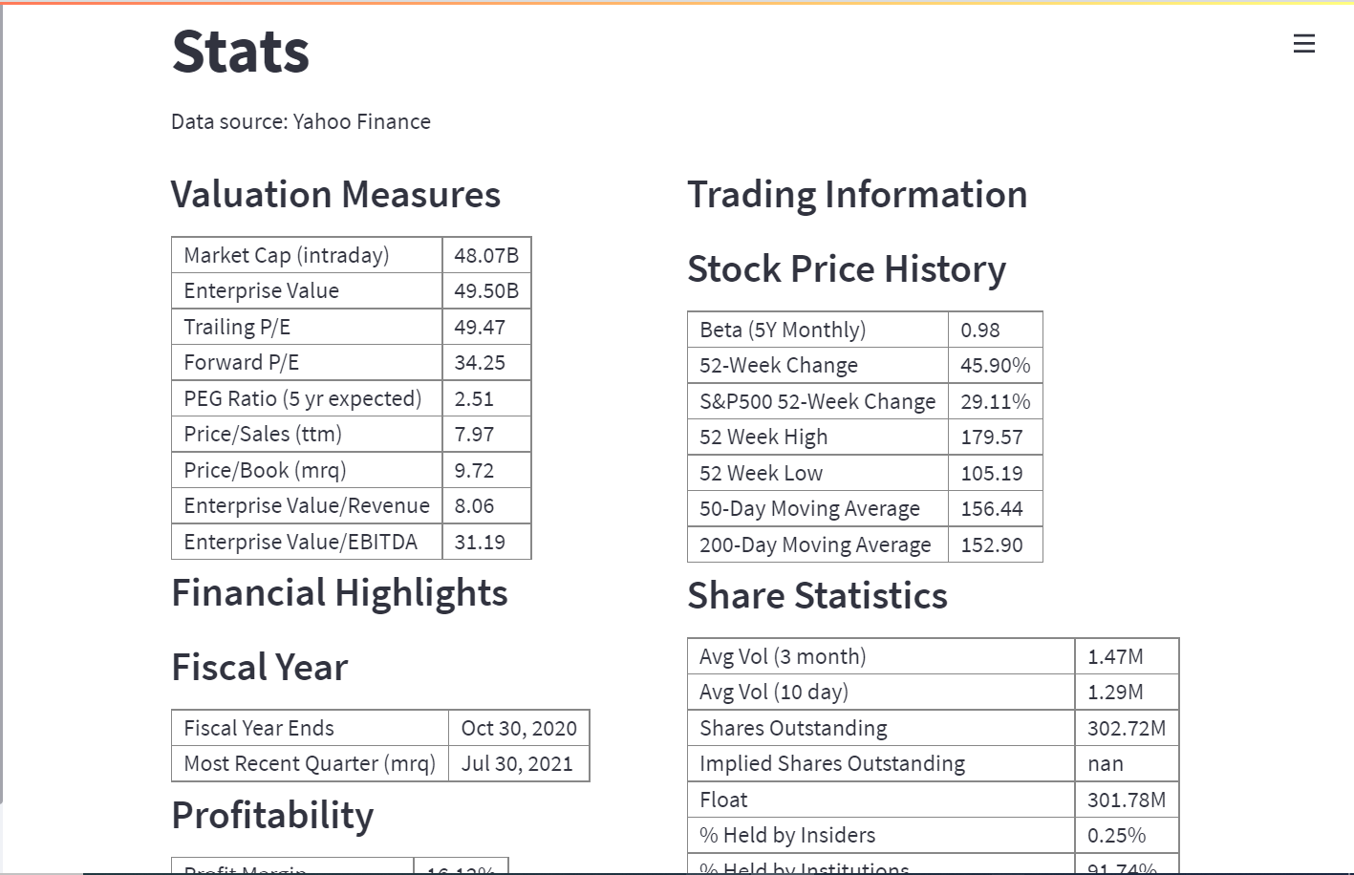
Statistics
Statistical data for the stock
Libraries Used:
  si.get_stats_valuation(ticker)
  si.get_stats(ticker)

Slide 5
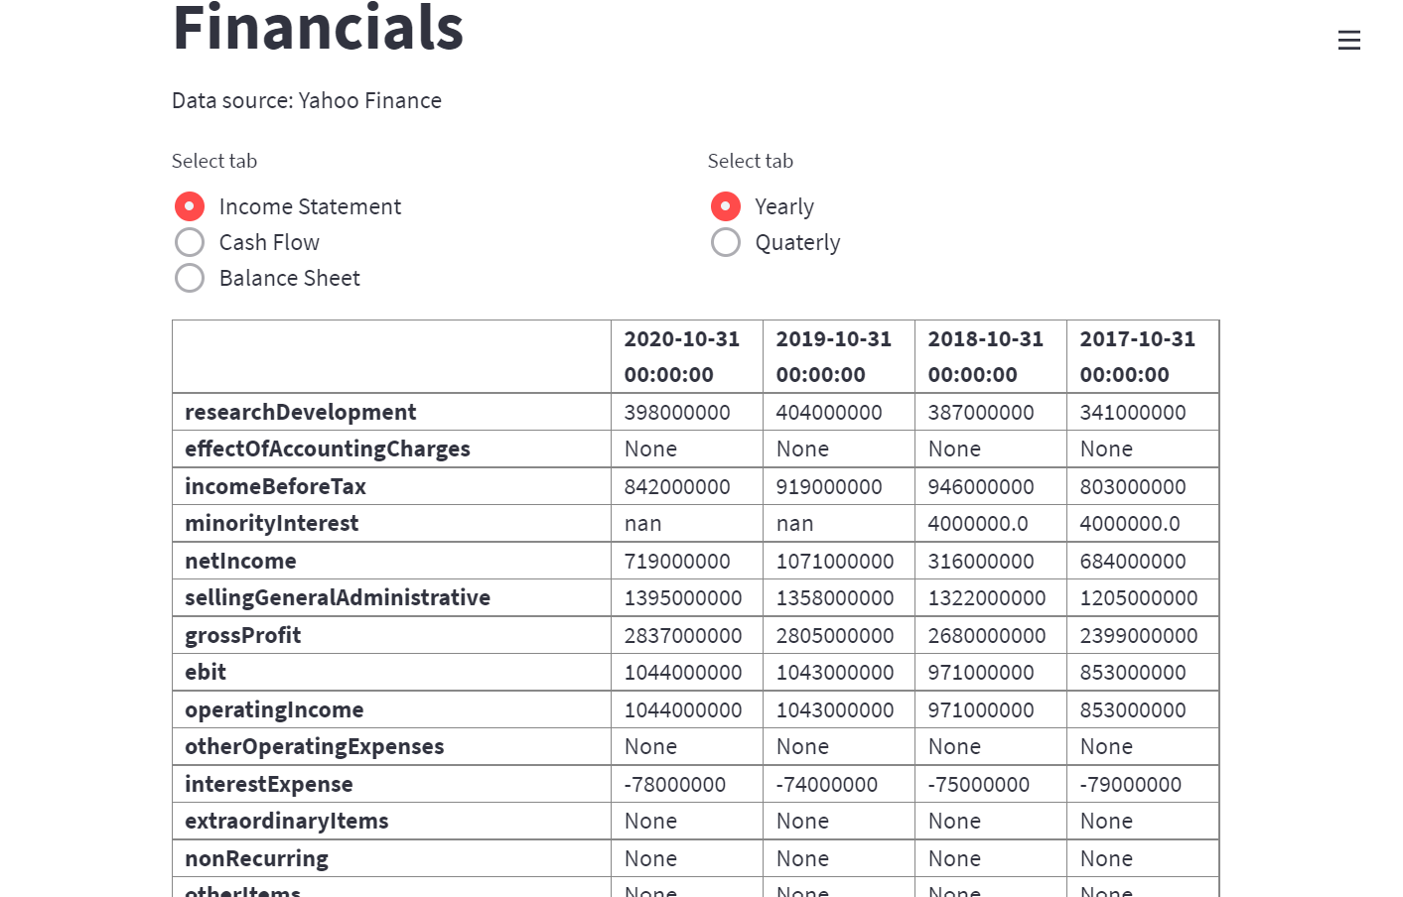
Financials
Financials data representing Cash Flow, Balance Sheet and Income Statement for the stock over quarterly and annually period
The default period is set to yearly
Libraries Used:
  si.get_income_statement(ticker, yearly=True)
  si.get_cash_flow(ticker, yearly=True)
  si.get_balance_sheet(ticker, yearly=True)

Slide 6
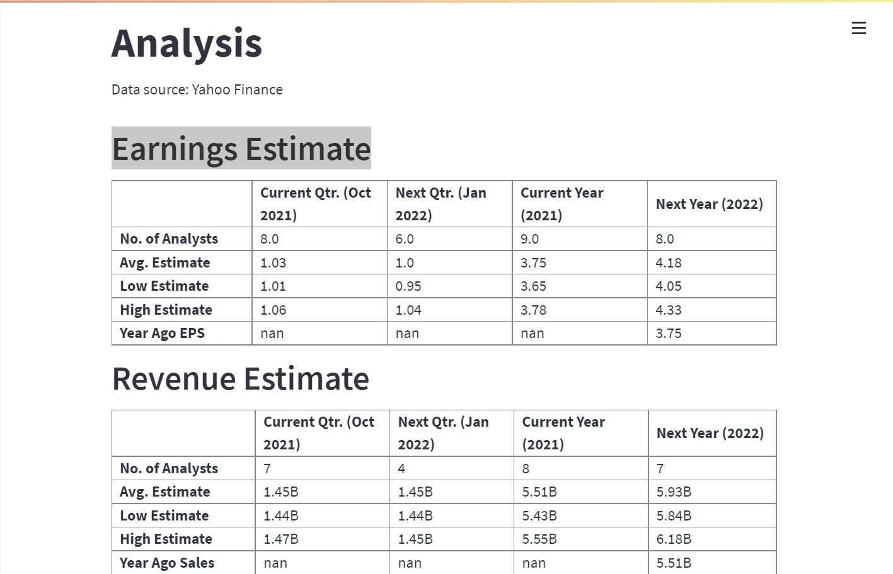
Analysis
Analyst data representing, Earnings Estimate, Revenue Estimate, Earnings History, EPS Trend, EPS Revisions, Growth Estimates,
Libraries Used:
  si.get_analysts_info(ticker)

Slide 7
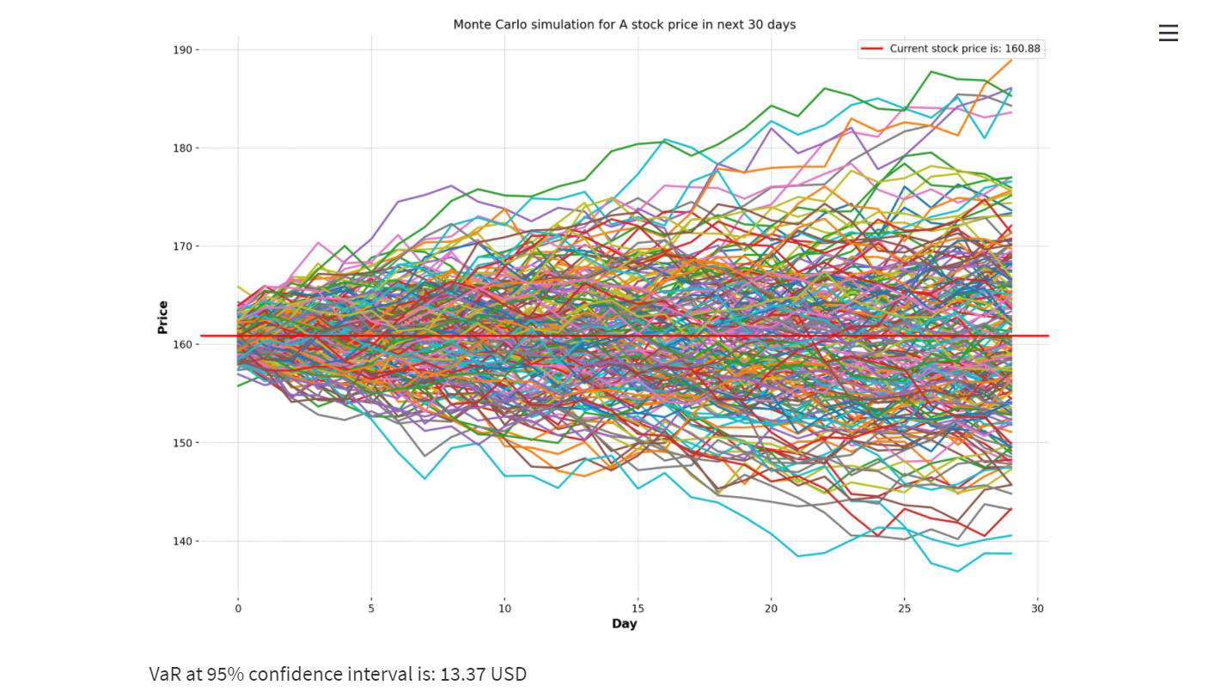
Monte Carlo
Monte Carlo simulation for the stock price in the next 30, 60, 90 days period from today
The number of simulation could be run is 200, 500, 1000 times
Libraries Used:
  si.get_data(tick, start_date, end_date)

Slide 8
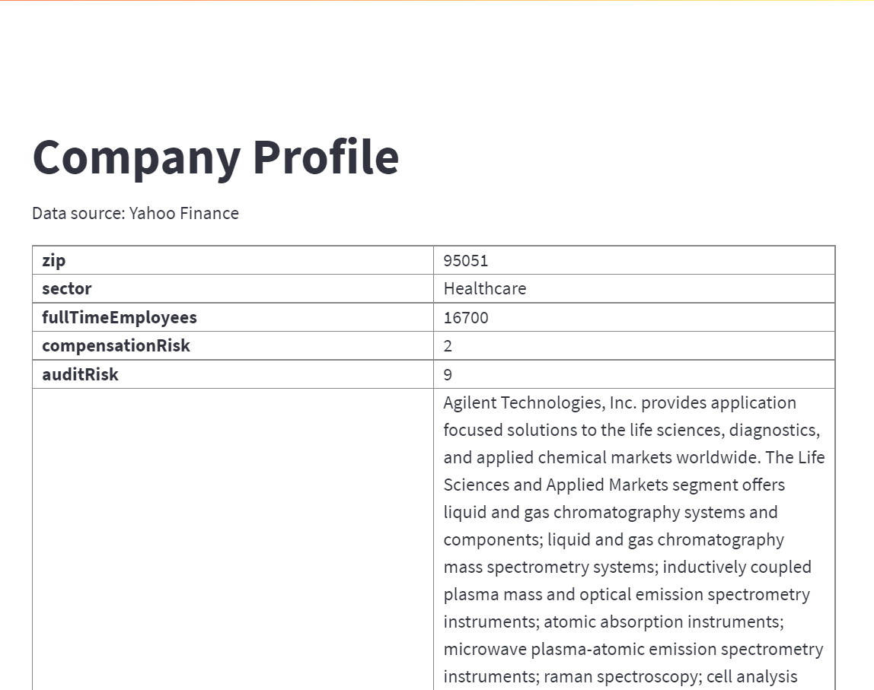
Company Profile
Displays the profile of the company
Libraries Used :
  si.get_company_info(ticker)

Slide 9
References
http://theautomatic.net/yahoo_fin-documentation/
https://finance.yahoo.com/
https://github.com/matplotlib/mplfinance
https://aroussi.com/post/python-yahoo-finance
https://docs.streamlit.io/library/api-reference
https://discuss.streamlit.io/t/how-can-i-display-this-chunk-of-html-output/2062/2

